Slide 1
Jmeter – powerful testing tool
Foundations of software testing
Rafał Nikiel
04.12.2015

Slide 2
AGENDA
Recap
HTTP POST
Database verification
External files
Performance

Slide 3
Other JMeter posibilities
Jmeter
DB connections and testing
Using external files to upload the data
Veryfing HTM and web services responses
Parsing documents
Distributed performance tests
Recording tests
And many many more...
Notes:
Possible issues:
Proxy
Lack od jdk installed
Java_home not set

Slide 4
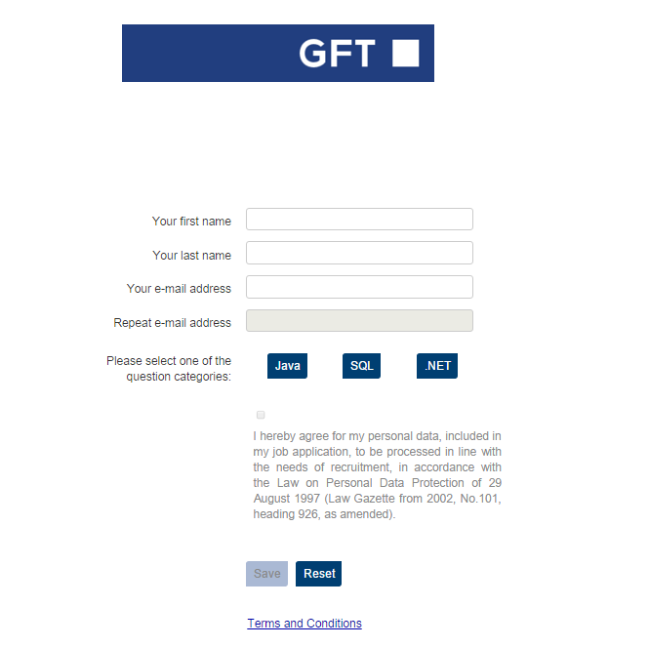
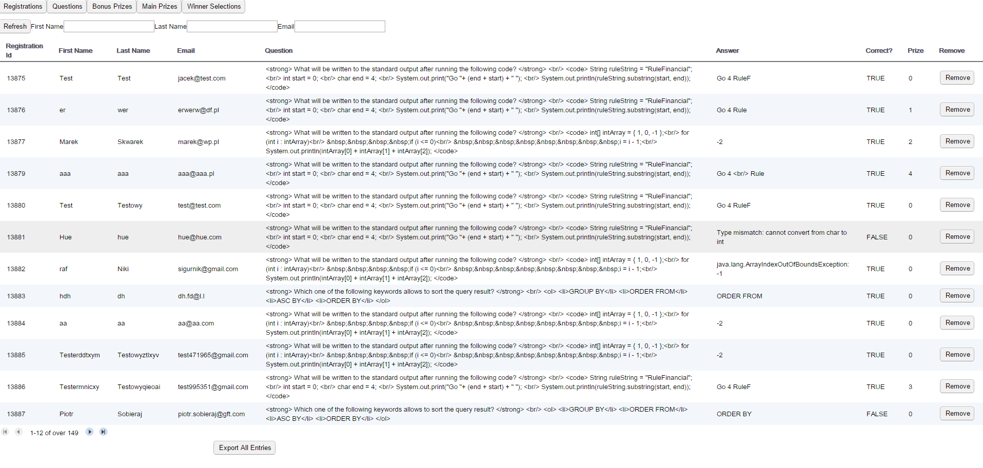
Preparing application
Jmeter ExcerciseS
Download RCApp zip from GITRepository (lesson-6)
Unzip the archive and go to tomcat bin directory (.. rcapp_external_db\rcapp\apache-tomcat-6.0.44\bin)
Run command line from that path and start tomcat by executing „startup” command
Once Tomcat server will be started go following url: http://localhost:8080/registrationform/?contestId=1
Check if you see the the screen similar to presented on the left
Administration panel should be available on http://localhost:8080/registrationpanel/
Login: admin
Passw:
Notes:
Possible issues:
Proxy
Lack od jdk installed
Java_home not set

Slide 5
Using HTTP Request [POST] to register new user
Jmeter ExcerciseS
Create an empty Test Plan and change its name to Test Plan – Task 3c
Save the test plan by the name of Task_3c.jmx.
Add Thread Group.
Add HTTP Request and change its name to HTTP Request – register user. Change the relevant settings as below:
a. Server Name or IP: 127.0.0.1
b. Port Number: 8080
c. Protocol [http]: HTTP
d. Method: POST
e. Content encoding: UTF-8
f. Path: /registrationform/registrations
Switch onto Body Data tab and put there xml content
Run test plan – response code 415
Add HTTP Header Manager and parameter Content-Type: text/xml
Run Test plan and check if user was registered
Run test plan again – what happened ?
Add Assertion for the Response code
<?xml version="1.0" encoding="UTF-8"?>
<REGISTRATION>
<FIRST_NAME>yourname</FIRST_NAME>
<LAST_NAME>yourlastname</LAST_NAME>
<EMAIL>your.mailj@gft.com</EMAIL>
<QUESTION>Which one of the following keywords allows to sort the query
result?
GROUP BY
ORDER FROM
ASC BY
ORDER BY</QUESTION>
<CHALLENGE>null</CHALLENGE>
<ANSWER>null</ANSWER>
<QUESTION_ID>7</QUESTION_ID>
<ANSWER_INDEX>28</ANSWER_INDEX>
</REGISTRATION>
http://localhost:8080/registrationpanel/
Login: admin
Passw:
Notes:
Possible issues:
Proxy
Lack od jdk installed
Java_home not set

Slide 6
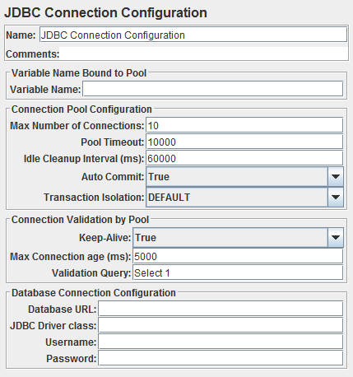
Preparing Jmeter for Database connection
Jmeter ExcerciseS
Default Jmeter version comes with no database driver
But it’s fairly easy to add i.e MySQL one:
Go to http://dev.mysql.com/downloads/file/?id=459313
Download and unzip the driver
Copy jar file (mysql-connector-java-5.1.37-bin) to Jmeter lib dierectory
Restart Jmeter
Main test plan elements when working with databases:
JDBC Connection Configuration
JDBC Request
Notes:
Possible issues:
Proxy
Lack od jdk installed
Java_home not set

Slide 7
Practice JDBC Requests
Jmeter ExcerciseS
In Test Plan from previous excercise add new config element – JDBC Connection Configuration and fill connection parameters
Add JDBC Request from Samplers. Use VariableName from configuration and write simple select to check if your POST request was stored in DB
Using Counter and Loop elements register more users (counter should be used to make emails unique)
Create new JDBC Request to clear generated data (use „like” operator not to delete others data !)
VariableName | RCappDB
Database URL | jdbc:mysql://db4free.net:3306/registrationsmob
JDBC Driver Class | com.mysql.jdbc.Driver
Username | rcapp
Password | Gfgjhjnybr!0
SELECT * FROM REGISTRATIONS WHERE EMAIL = ’your_email';
Notes:
Possible issues:
Proxy
Lack od jdk installed
Java_home not set

Slide 8
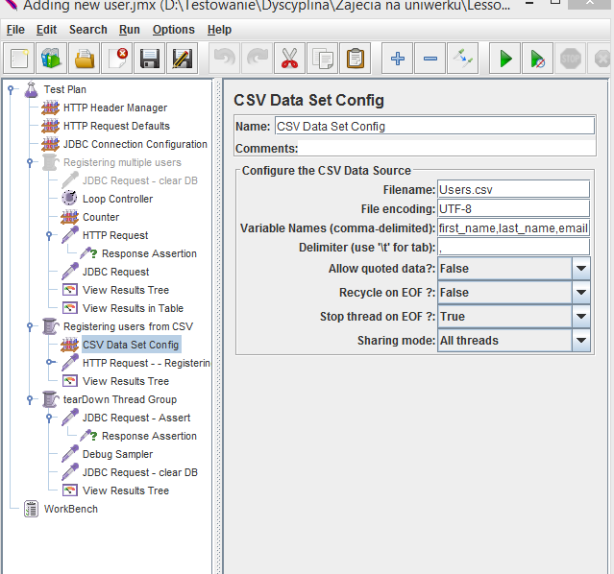
Using external file in test scenario
Jmeter ExcerciseS
Often in a real world examples there is a common need to prepare and keep test data in external files
Create Users.csv file with few users data (first name, last name, email). Each user in new line and values separated by given delimiter (e.g. coma, pipe). Save file in the same place where JMX file is stored.
Add new Thread Group and disable recent one. Check Forever checkbox.
Add CSV Data Set Config component and provide filename, encoding(UTF-8), variable names(e.g. first_name,last_name,email) and delimiter parameters. Other flags set to: Allow quoted data – False Recycle on EOF – False Stop thread on EOF – True Sharing mode – All Threads
Copy HTTP Post from previous excercises and use email parameter in HTTP Request name and POST body
Add tearDown Thread Group
Add JDBC Request with Assertion element to check if users from CVS will be registered (use select count(*) and Jmeter variable assertion).
Add JDBC Request for clearing DB after test.
Add Result Tree for both Thread groups and run Test Plan
Notes:
Possible issues:
Proxy
Lack od jdk installed
Java_home not set

Slide 9
Preparing and executing Performance test
Jmeter ExcerciseS
Using solutions from previous excercise prepare bigger test data ~100 users
Add Agregate graph and run test plan to see response times
Notes:
Possible issues:
Proxy
Lack od jdk installed
Java_home not set

Slide 10
Rafał Nikiel
GFT
Rafal.Nikiel@gft.com

